Slide 1




PREDICTION
MAMATHA A U • MACHINE LEARNING
Decision Tree, Random Forest, and SVM predict breast cancer using machine learning.

Slide 2

THE EARLY DETECTION CHALLENGE
Breast cancer is among the most common cancers affecting women worldwide. Early detection gives doctors a better chance to identify disease promptly and choose appropriate care. When diagnosis comes sooner, treatment can begin in time to improve success and reduce mortality. This challenge motivates a machine learning approach that can distinguish tumor types with useful reliability.
A model that reliably distinguishes benign from malignant tumors can support earlier, more informed clinical decisions. This project aims to classify tumors as non-cancerous or cancerous, helping direct patients toward timely diagnosis and appropriate care. A clear goal: improve detection and treatment outcomes.

Slide 3
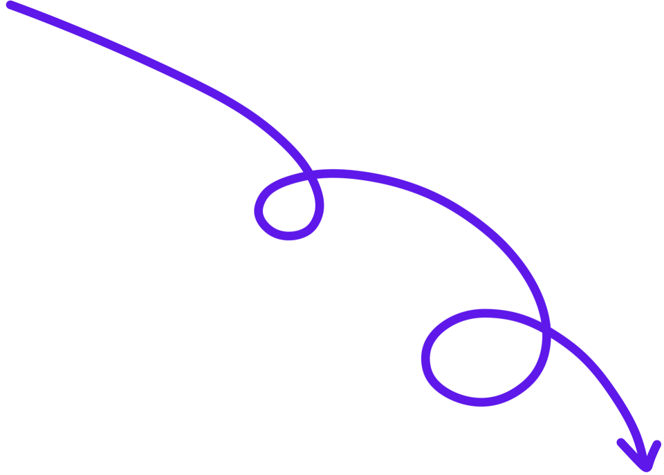

DATASET OVERVIEW
I
II
III
30 FEATURES
569 RECORDS
TWO CLASSES

Slide 4
DATA PREPROCESSING
Removed unwanted index columns to keep only meaningful data fields.
Checked for missing values to identify incomplete records before analysis.
Reviewed duplicate records to prevent repeated observations from skewing results.
Encoded target classes with B mapped to 0 and M mapped to 1.
Separated features from the target to prepare the cleaned data for modeling.

Slide 5


PREPARING THE DATASET
Data split
Training set
Test set
We divide the dataset into 80% for model training.
The training set contains 80% of the dataset and is used to teach the model to identify patterns.
The remaining 20% is reserved for testing to evaluate how well the trained model performs on unseen data.

Slide 6
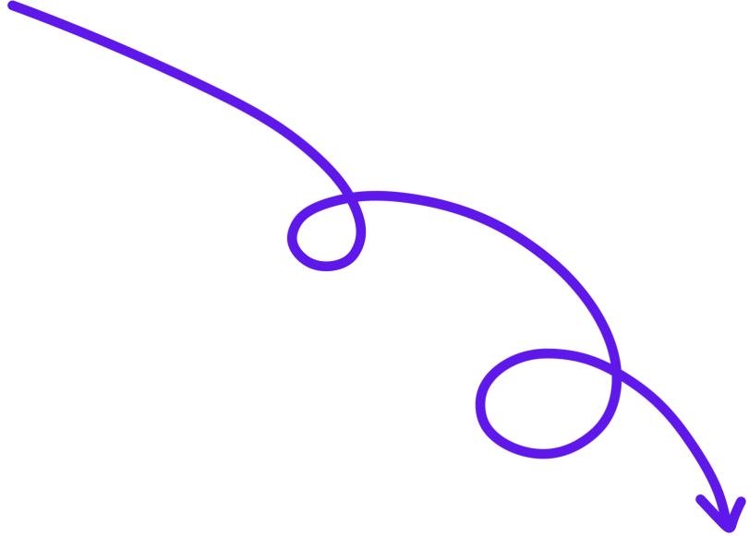

THREE CLASSIFICATION APPROACHES
DECISION TREE
RANDOM FOREST
SUPPORT VECTOR MACHINE
an interpretable tree structure assigns classes through clear decision paths
combines many decision trees to improve predictive accuracy
finds an optimal hyperplane to separate classes for effective classification
Decision trees make outcomes interpretable;ensemble and margin methods strengthen classification.

Slide 7
TRAINING WORKFLOW
1
2
3
4
5
Prepare and clean the dataset for modeling
Split data into training and test sets
Train Decision Tree, Random Forest, and SVM
Generate predictions from each trained model
Evaluate results and compare model performance
The workflow prepares and splits the dataset before fitting three complementary models. Each model then generates predictions, and results are evaluated to compare performance and understand how well the models generalize.

Slide 8
RESULTS
I
II
III
SVM
Accuracy : 97.37%
RANDOM FOREST
Accuracy : 96.49%
Decision Tree
Accuracy : 92.98%

Slide 9
UNSEEN DATA RESULTS
Five unseen samples were submitted to the trained model for prediction, providing a small test of how it handles cases beyond the data used during development.
The first test sample was classified as benign, indicating that the model assigned it to the non-malignant category based on the patterns it learned.
The second sample was classified as malignant, distinguishing it from the other four test cases and reflecting the model’s prediction for this unseen input.
Samples three and four were both classified as benign, extending the benign predictions across the majority of this five-sample test set.
The fifth sample was also classified as benign; overall, four samples were predicted benign and one malignant, demonstrating successful predictions on these unseen cases.

Slide 10


SVM LEADS TUMOR CLASSIFICATION
92.98%
96.49%
97.37%
DECISION TREE
RANDOM FOREST
SVM · HIGHEST
KEY TAKEAWAYS
Breast cancer prediction system successfully implemented
Three algorithms compared: Decision Tree, Random Forest, SVM
SVM achieved the highest accuracy at 97.37%
Tumors effectively classified as benign or malignant
Supports early diagnosis and better patient outcomes

Slide 11
Thank You

